Slide 1
Introducing Capaccioli
machinery and plants for clay industry

Slide 2
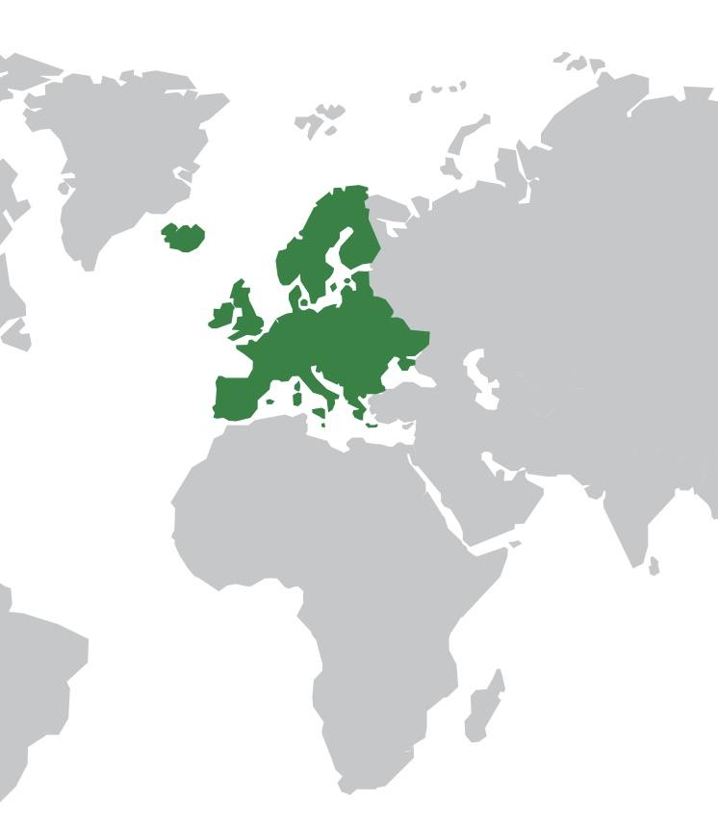
Capaccioli in the world
Europe
europe@capaccioli.com
Asia
asia@capaccioli.com
South America
southamerica@capaccioli.com
Africa
africa@capaccioli.com
Australia
australia@capaccioli.com
Sales agent to the Benelux, Germany
and United Kingdom:
Wouter van der Heide
+31 (0) 637696833

Slide 3
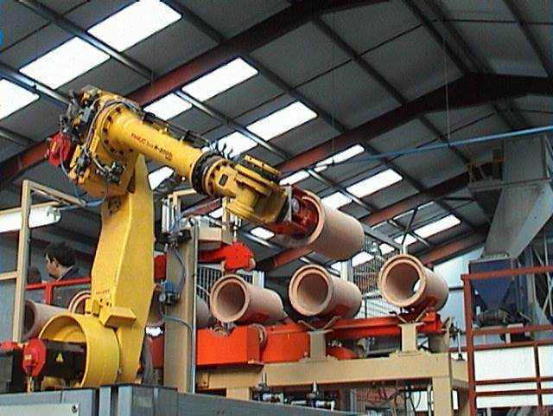
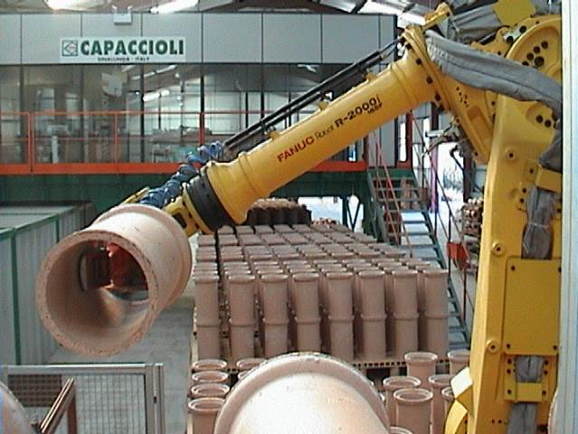
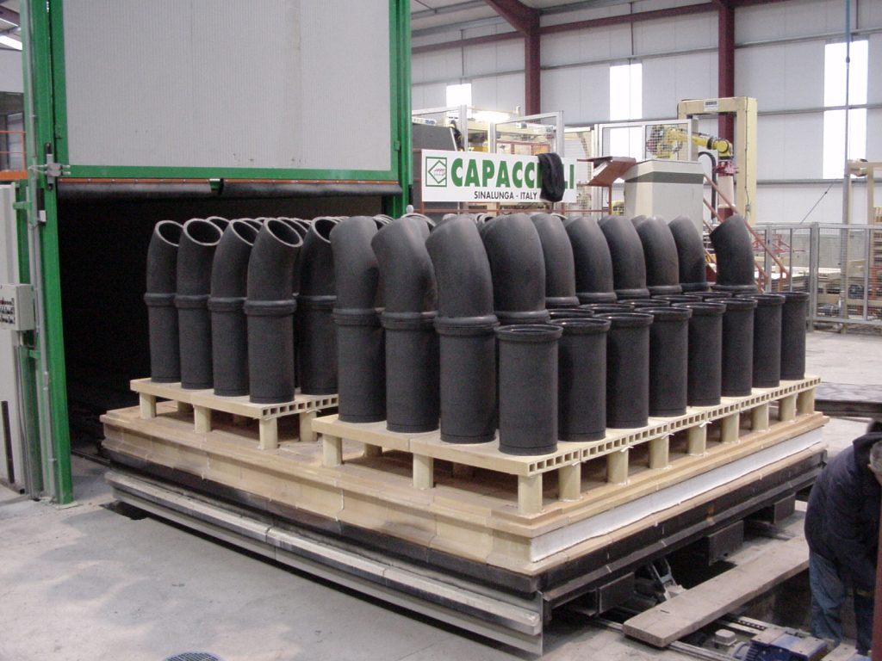
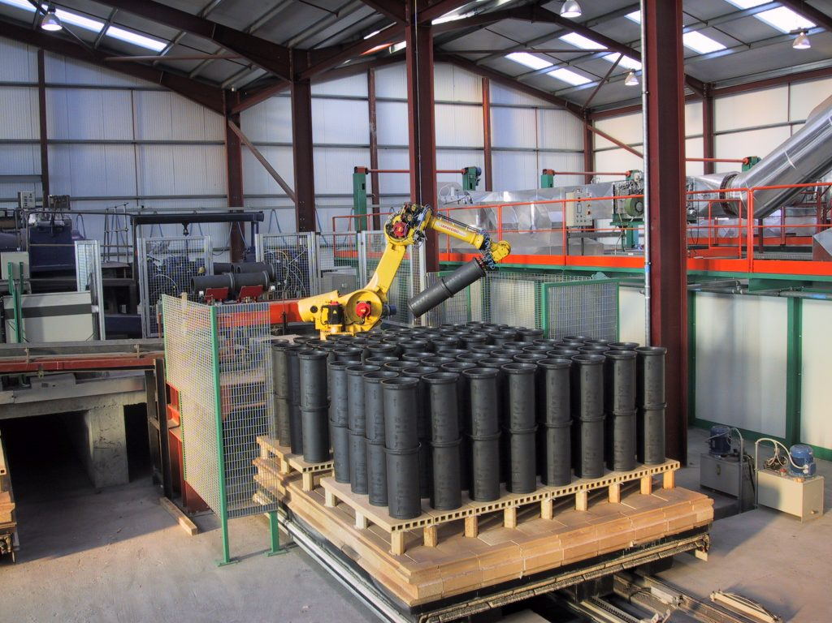
Capaccioli: Flemings Fireclay Manufacturing (Ireland)

Slide 4
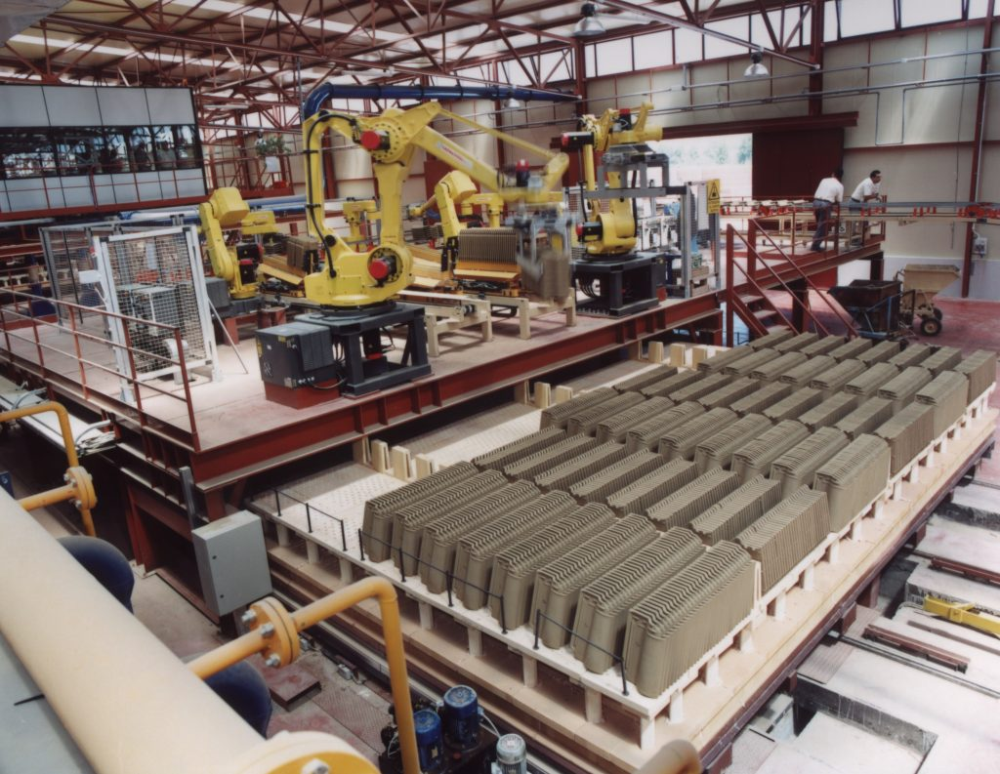
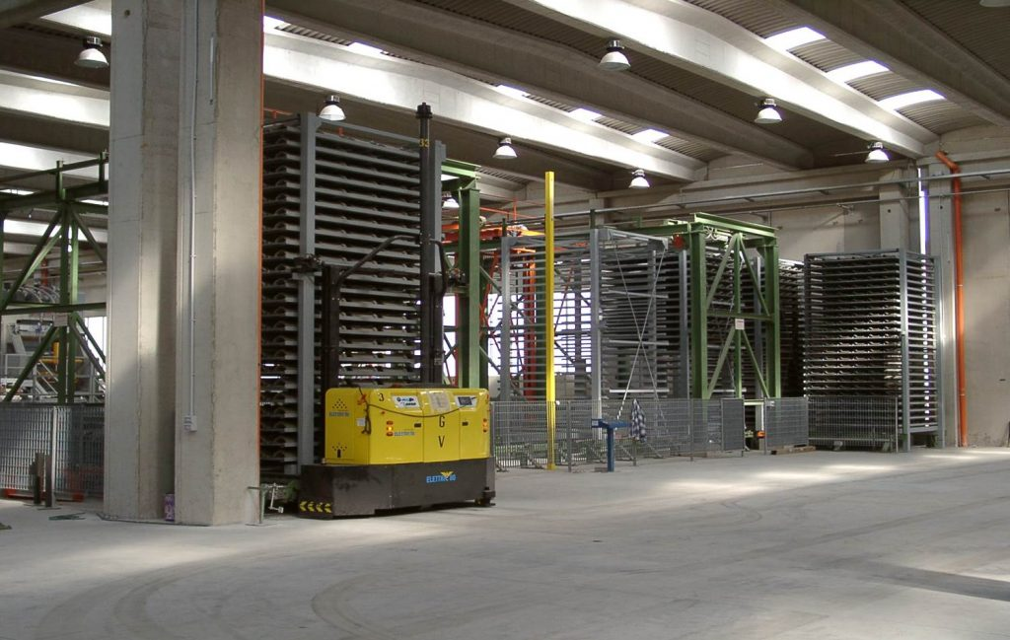
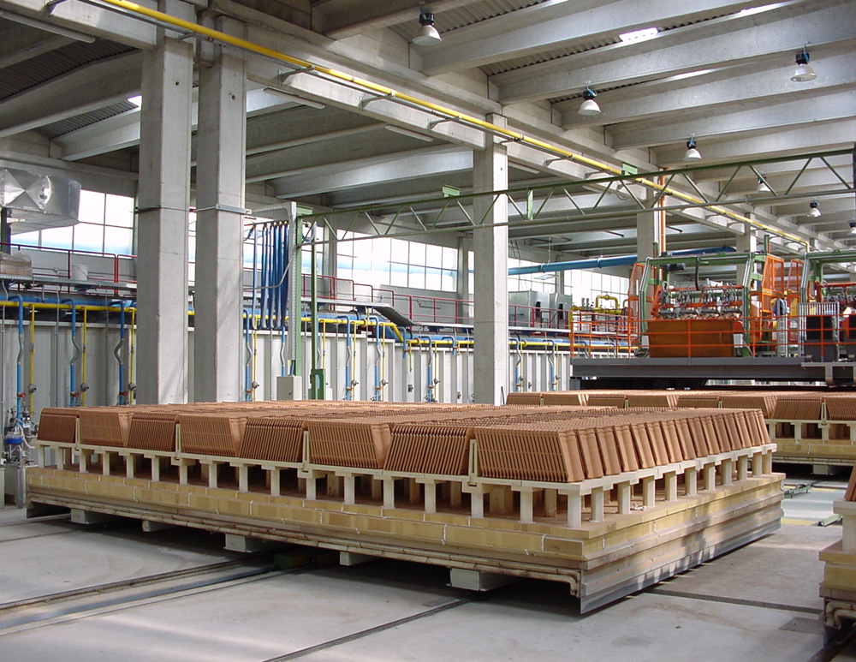
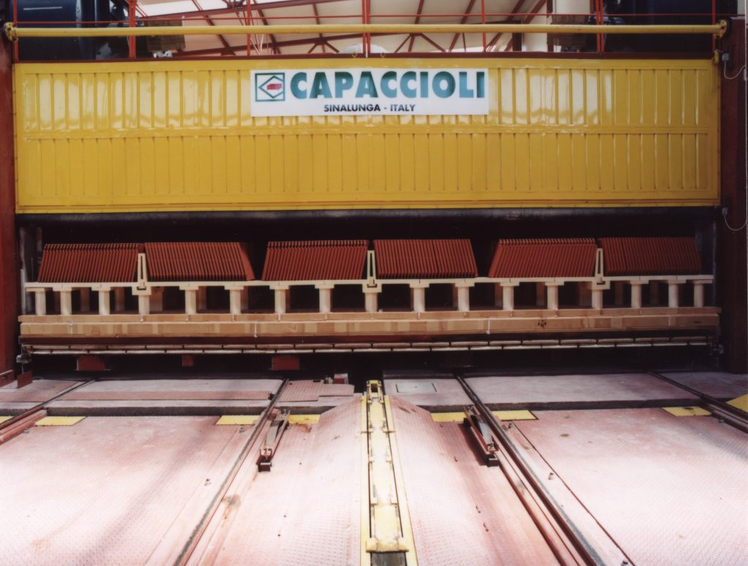
Capaccioli: Maestrale S.r.l. (Italy)

Slide 5
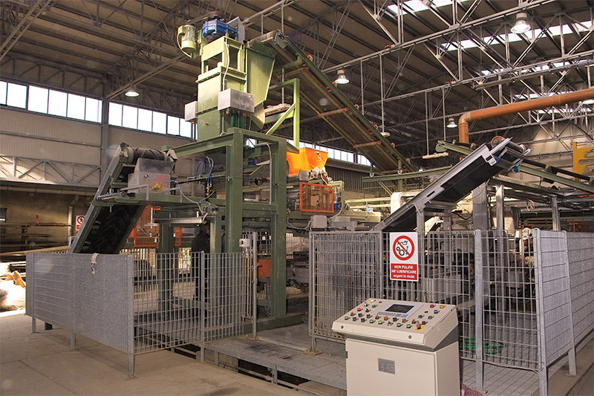
Capaccioli: Pratigliolmi – Cotto Nobile di Toscana (Italy)

Slide 6
Capaccioli: Latest constructions
ZUMRUT (TURKEY) New plant for 750 ton/day of Hollow blocks with CONDOR Ultra Fast Dryer
AYDIN TUGLA (TURKEY) New plant for 750 ton/day of Hollow blocks with CONDOR Ultra Fast Dryer
EJDER (TURKEY) New plant for 750 ton/day of Hollow blocks with CONDOR Ultra Fast Dryer
5th ELEMENTH (RUSSIA) Kiln Upgrade
SHUANGYASHAN ORIENTAL WALL MATERIAL GROUP CO., LTD (CHINA) New Kiln
KILSAN SA (TURKEY) Cutting line and dryer loading with robot
KILSAN SA (TURKEY) Complete unloading line
KILSAN SA (TURKEY) Extruder 650 for extrusion line renovation
SARL BRIQUETERIE ZENATA (ALGERIA) Dryer extension
SARL BRIQUETERIE ZENATA (ALGERIA) Complete plant for bricks 280.000 ton/year
SARL BRIQUETERIE TAFNA (ALGERIA) N.2 Unloading lines and strapping
SARL BRIQUETERIE BANOU MESSAUD (ALGERIA) Plant 400.000 ton/year
SARL BRIQUETERIE NAILI (ALGERIA) Plant 200.00 ton/year

Slide 7
Capaccioli: Latest constructions
OUARSENIS (ALGERIA) Bundles’ Unloading system
ATTIA SALAH (ALGERIA) Bundles’ Unloading system
HEUMIS (ALGERIA) Bundles’ Unloading system
MOCCIA (ITALY) Automatisms for cutting, dryer loading and unloading
LA BRIQUE TUNISIENNE (TUNISIA) N.2 Unloading lines
LA BRIQUE TUNISIENNE (TUNISIA) Kiln 1 renovation
LA BRIQUE TUNISIENNE (TUNISIA) Kiln 2 renovation
LA BRIQUE TUNISIENNE (TUNISIA) Dryer renovation
LA BRIQUE TUNISIENNE (TUNISIA) Disintegrator LD1208
LA BRIQUE TUNISIENNE (TUNISIA) Bucket excavator
EL KHAYATT (KSA) Kiln 4 renovation
EL KHAYATT (KSA) Kiln 3 renovation
EL KHAYATT (KSA) New unloading lines

Slide 8
Capaccioli: Latest constructions
CERSANIT ROMANIA SA (ROMANIA) Complete plant clay preparation and chamotte milling
BRISTILE (AUSTRALIA) Machinery and accessories for clay preparation plants
BALTKERMIKA (RUSSIA) Clay preparation machinery
TORGOVI DOM (RUSSIA) Bucket excavator

Slide 9
Capaccioli: Complete plants
Ceramica S.A., Iasi (Romania) Complete robotic plant for hollow blocks production of 750 ton/day
Ceramica S.A., Iasi (Romania) Complete robotic plant for hollow blocks and blocks of 300 ton/day
Cottocoperture (Gruppo Lafarge), Salandra (Matera, Italy) Complete plant for roof tiles production of 25.000.000 piece/year with the use of 17 robot, continuous dryer and mono-layer tunnel kiln
Maestrale S.r.l., Giammoro (Messina, Italy) Complete plant for roof tiles production of 40.000.000 piece/day, static dryer and mono-layer tunnel kiln
Flemings Fireclays (Ireland) Complete plant for chimneys production (680.000 piece/year) with the use of 3 robot, continuous dryer and double layer kiln

Slide 10
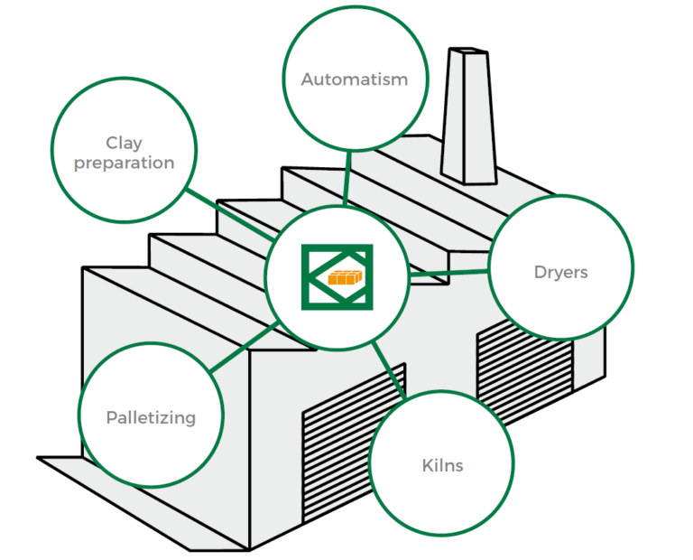
Capaccioli: design and plant construction
Thanks to a professional team of
Engineers and an experienced staff
of technicians Capaccioli is always
one step beyond, offering the latest
solutions to its customers.
Capaccioli engineers design using the most
updated CAD systems and before delivery
every machinery undergoes a strict test
and quality program, giving the best
guarantees in terms of reliability,
durability and efficiency.

Slide 11
Capaccioli: design and plant construction
Complete plants (tiles, wall blocks, hollow bricks and ceilings, Easymud soft mud plants).
We design and build complete plants for the production of extruded, pressed and soft
mud roof tiles with possibility of glazing and engobbing with traditional and/or robotic
technology. In detail we produce: – Traditional firing plants for 20/30/40 million roof tiles/year – H-cassettes firing plants for 15/20 million roof tiles/year – Fast firing plants for 10 million roof tiles/year
Through the EASYMUD technology, we develop complete and automatic systems for
floors, face covering bricks and special pieces in soft mud with “handmade”
characteristics, with several surface finishing.

Slide 12
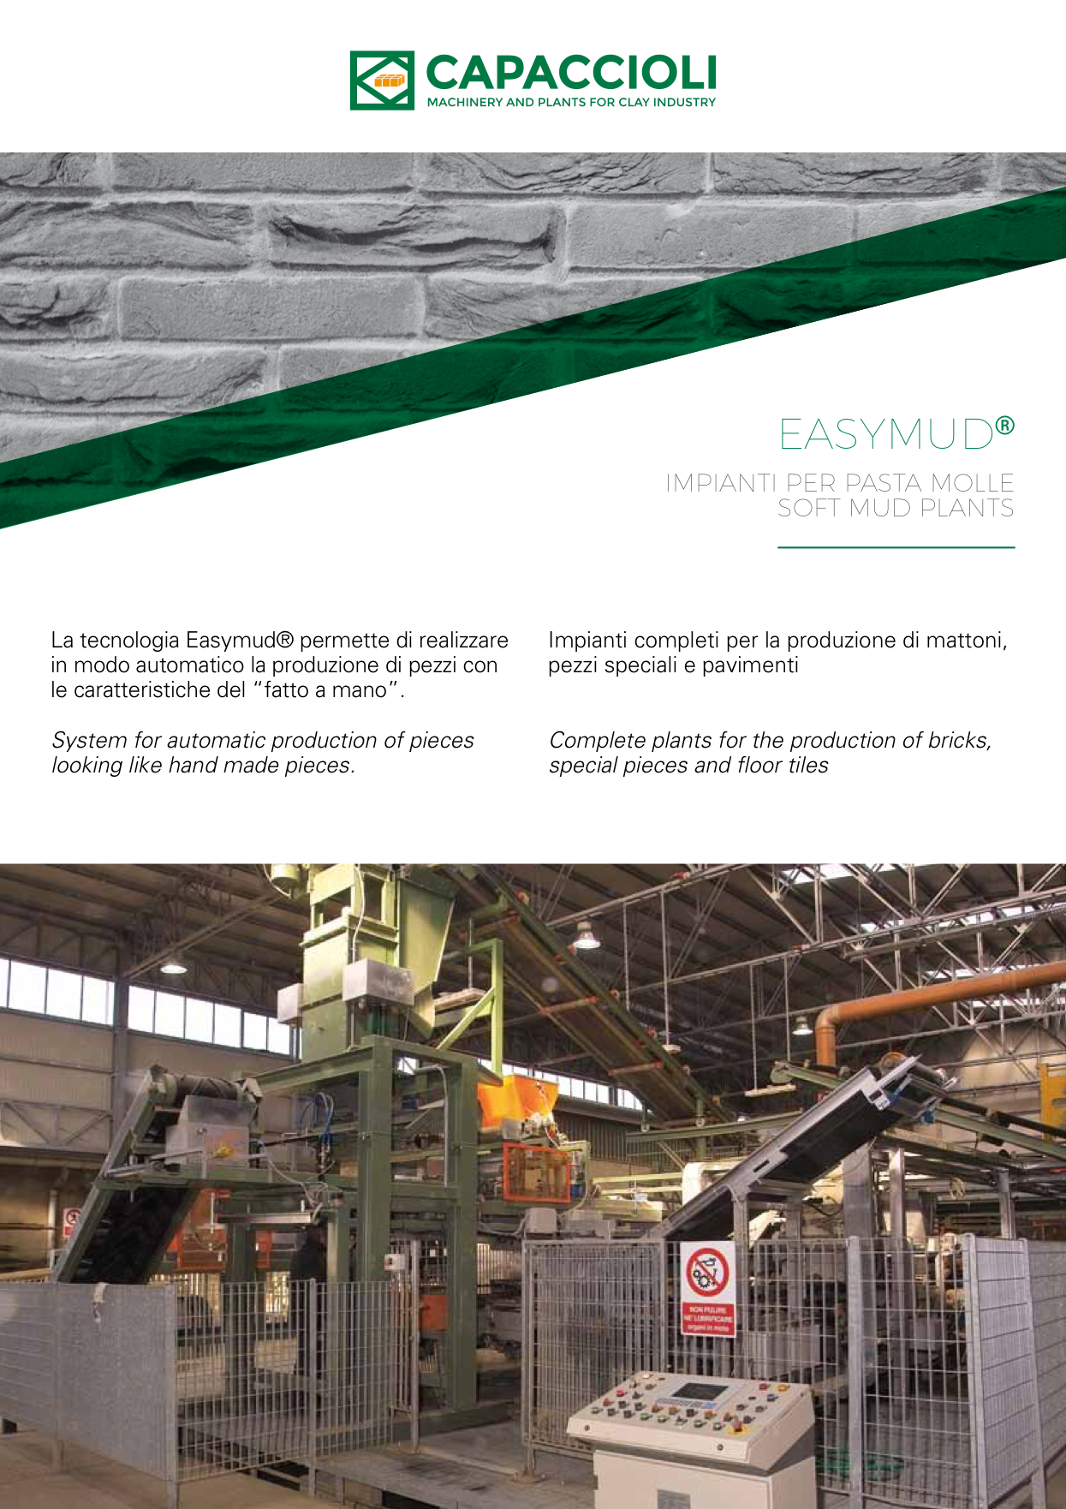

Slide 13
Capaccioli: kilns
According to the analysis of
raw materials carried out in
our equipped laboratories, our
technical staff is able to give
the best technological solutions
for the kiln firing cycles.

Slide 14
Capaccioli: burners

Slide 15
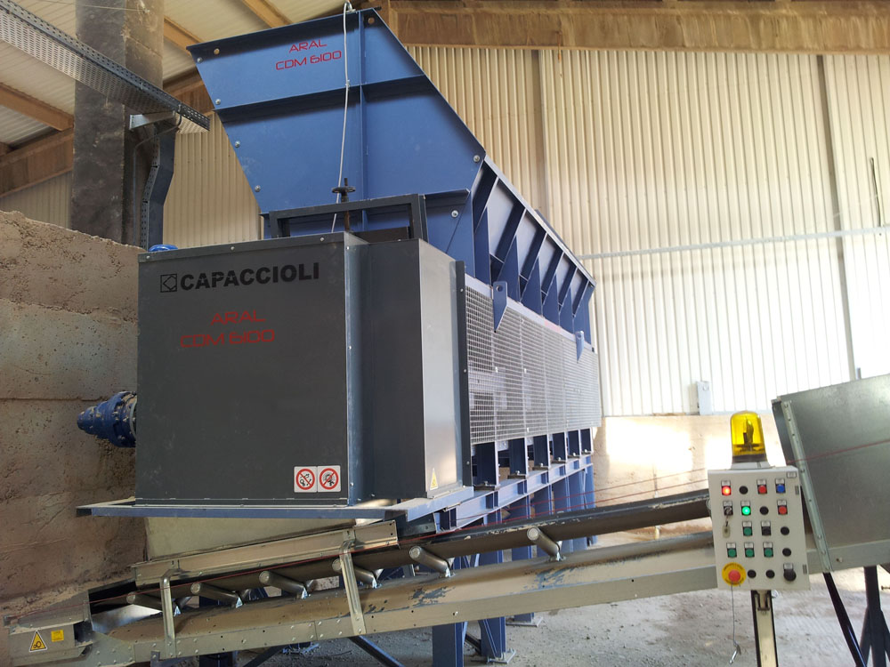
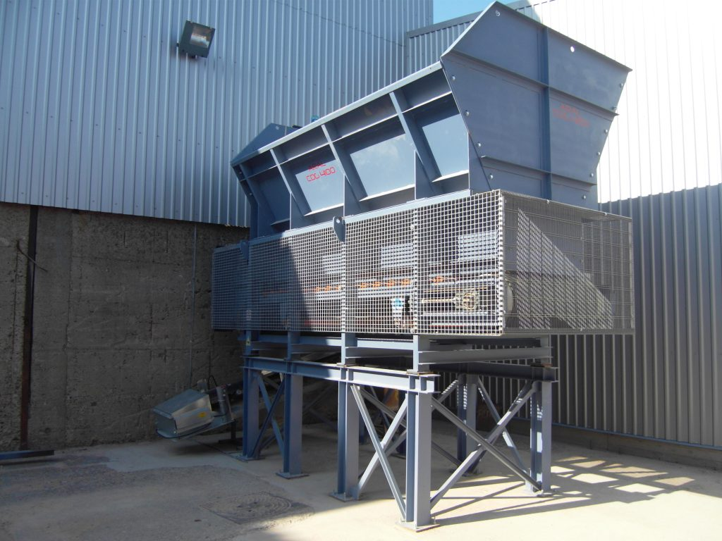
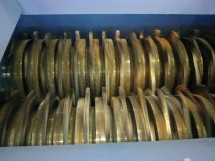
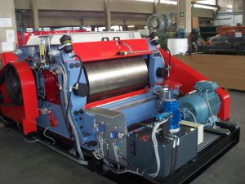
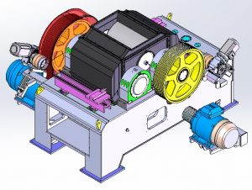
Capaccioli: a view examples

Slide 16
Capaccioli Metal Box Feeder – CDM Series
Metal Box feeder is
intended to feed the
production line with
the raw material.

Slide 17
Capaccioli: Rubber Box Feeder – CDG Series
This box feeder is
intended to feed the
production line by
adjuvants.

Slide 18
Capaccioli: Clay Crushers Series – FD Series
This machine can work with
clay and other mineral ware
with granulometry up to 500 mm.
The finishing material can reach
granulometry of variable
(30÷150mm).

Slide 19
Capaccioli:Clay Disintegrator – LD Series
The clay disintegrator is used to
reduces the clay granulometry to
a homogeneous size from 15
and 30 mm. The machine overall
design is quite similar to the
roller mill.

Slide 20
Capaccioli: Roller Mill – LS Series
The roller mill is suitable to work
with clay particles with
dimensions of few millimeters.

Slide 21
Capaccioli: Roller Mill – LF Series
The fast roller mill refines clay
into very small particles

Slide 22
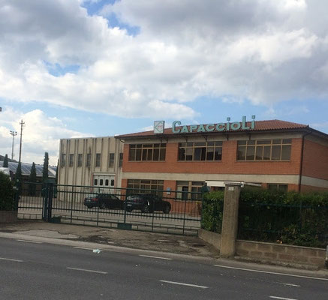
Capaccioli: an Italian family-owned company CAPACCIOLI s.r.l. Via Piave, 51 - 53048 Sinalunga (SIENA) - ITALY Tel +39.0577.679296 - Fax +39.0577.678218 mec@capaccioli.com - P.IVA 00127270528 N. REA 64163 Fully paid-up share capital 1.000.000 euro CAPACCIOLIMPIANTI s.r.l. Via Piave, 51 - 53048 Sinalunga (SIENA) - ITALY Tel +39.0577.679296 - Fax +39.0577.678218 mec@capaccioli.com - P.IVA 01001390523 N. REA 112925 Share capital 100.000 euro

Slide 23
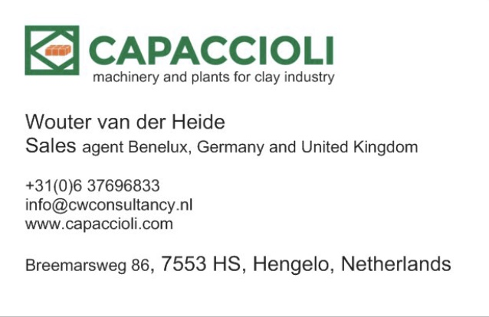
Capaccioli: an Italian family-owned company

